Slide 1
Session 3
Advanced User
Interface Enhancements

Slide 2
Review
The different Controls are grouped into different types depending on the functionality they offer.
Text Edit Controls allow users to enter and edit text while Text Display Controls only display text to the user.
Selection list Controls display a set of values to the user and allow users to select a value from the list.
Graphic storage Controls store graphics, such as images, in it and Graphic Display Controls are used to display graphics, such as images.
RichText Controls are text controls that are enriched with extra functionality that differentiate them from other text controls.

Slide 3
Review Contd…
Value Setting Controls help users to set values, such as ‘yes’ or ‘no’.
Dialog Boxes Controls provide basic functionality like the Save dialog box, Open dialog box and Print dialog box.
Menu Controls provide the menu functionality to the user while Commands controls allow users to interact with the application.
A set of controls can be grouped using Grouping Controls.
The steps involved in calling a form from another form are:
  Create an instance of the form to be called
  Show the instance

Slide 4
Objectives
Discuss print support in Winforms
List different types of Dialog Boxes
Work with system defined Dialog Boxes
Implement User Interface Capabilities
  Transparent Forms
  Control Docking
  Control Anchoring
  Visual Inheritance

Slide 5
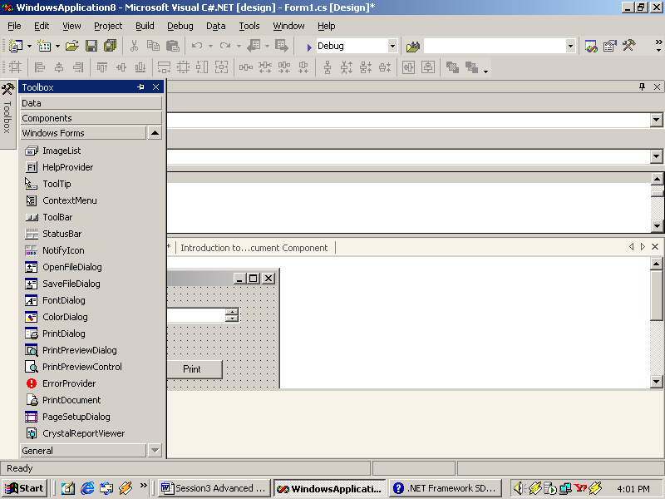
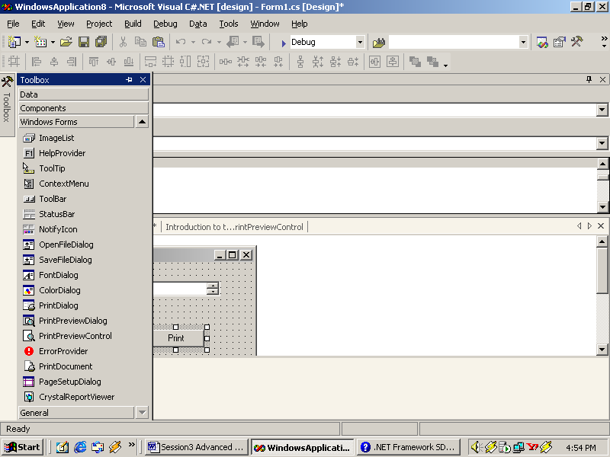
Printing Support Controls
PrintDocument
PrintPreviewControl

Slide 6
PrintDocument
Events
Properties
PrintPage
DocumentName
BeginPrint
PrintController
EndPrint
PrinterSettings
Methods
QueryPageSettings
DefaultPageSettings
Gettype
Print
ToString

Slide 7
PrintPreviewControl
Properties
Zoom
UseAntiAlias
Methods
StartPage
Document
AutoZoom
Columns
InvalidatePreview
Rows

Slide 8
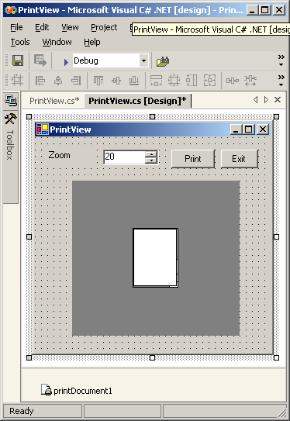
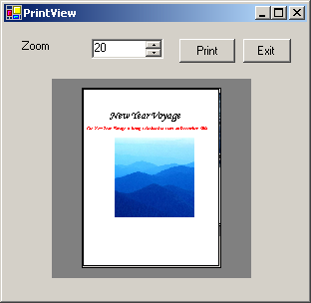
Print Support Controls - Example
PrintPreviewControl
PrintDocument

Slide 9

Dialog Boxes
To display information and messages for the user
To accept user-input
Uses
Types (by Presentation)
Modal
Modeless

Slide 10
Dialog Types
Types of Dialog (by definition)
  Custom Dialog Boxes
  Common Dialog Boxes
  OpenFileDialog
  PageSetUpDialog
  FontDialog
  ColorDialog
  SaveFileDialog
  PrintPreviewDialog
  PrintDialog

Slide 11
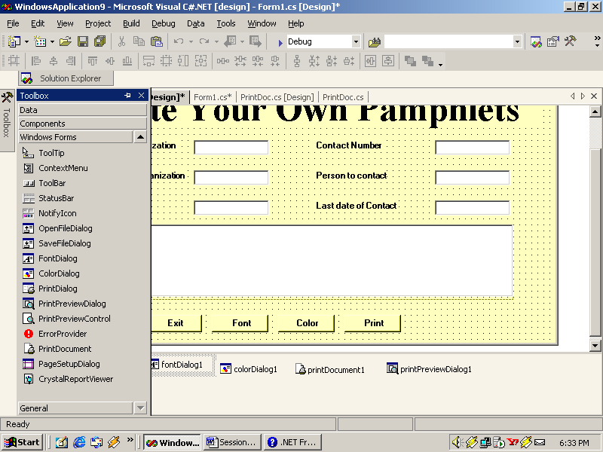
OpenFileDialog
ShowReadOnly
RestoreDirectory
AddExtension
FileName
Properties
ReadOnlyChecked
CheckPathExists
Title
ShowHelp
IntialDirectory
FilterIndex
FileNames
CheckFileExists
MultiSelect
DefaultExt
Filter
ValidatesNames

Slide 12
OpenFileDialog Contd…
Events
Methods
HelpRequest
OpenFile
FileOk
ShowDialog

Slide 13

PageSetUpDialog
AllowOrientation
PrinterSettings
AllowMargins
AllowPrinter
Properties
Document
ShowHelp
ShowNetwork
AllowPaper
MinMargins
PageSettings

Slide 14
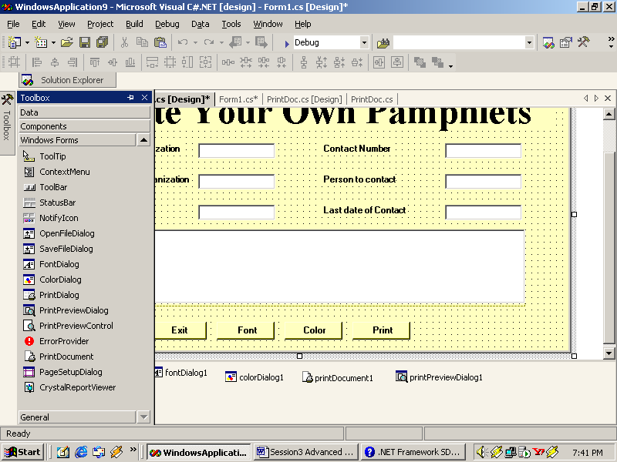
FontDialog
AllowScriptChange
Properties
AllowVectorFonts
AllowSimulations
AllowVerticalFonts
ScriptsOnly
ShowColor
ShowEffect
FontMustExist
Font
MinSize
MaxSize
ShowApply
Event
Color
ShowHelp
FixedPitchOnly
Apply

Slide 15
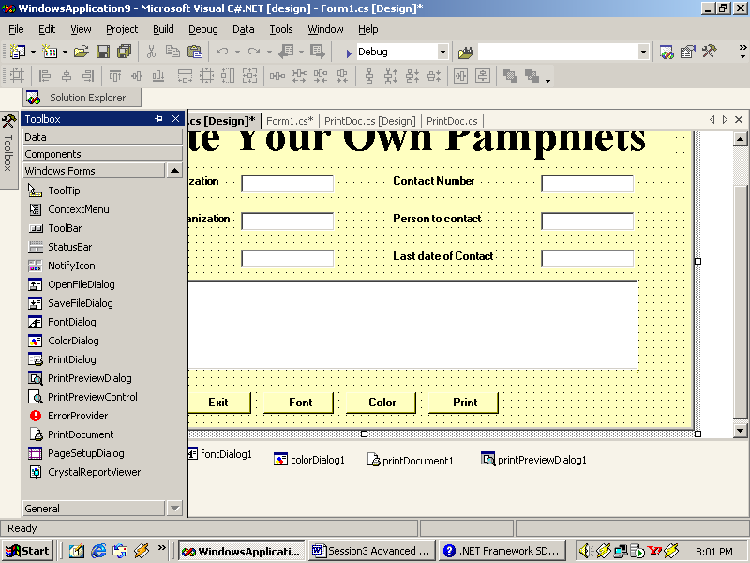
ColorDialog
Color
AnyColor
CustonColor
Properties
SolidColorOnly
AllowFullOpen
ShowHelp
FullOpen

Slide 16
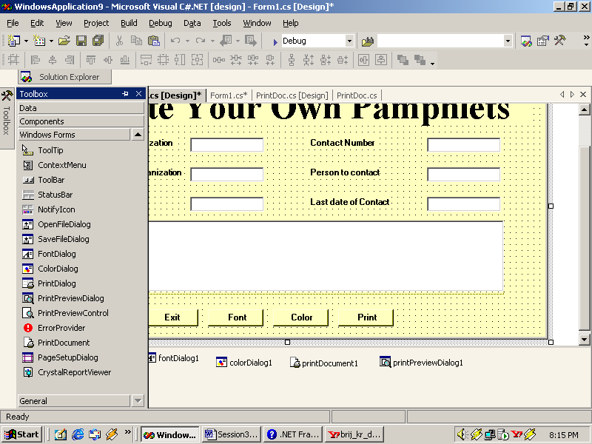
SaveFileDialog
Properties
Method
OverwritePrompt
OpenFile
CreatePrompt

Slide 17
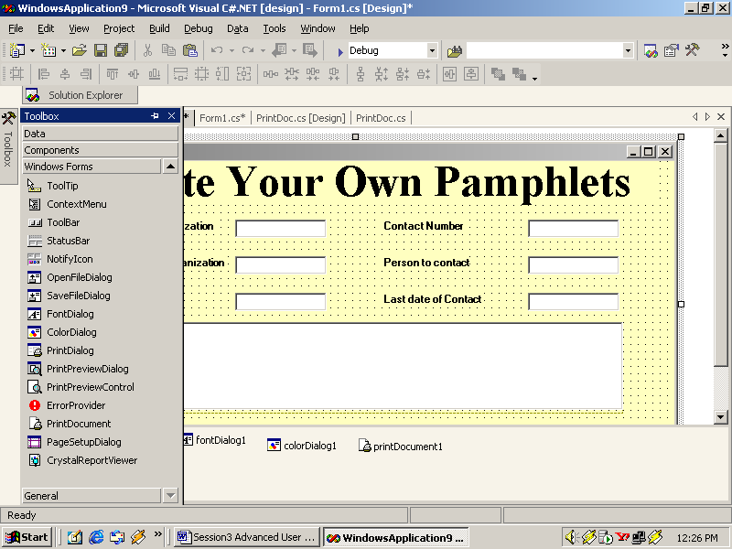
PrintPreviewDialog
Property
Document

Slide 18
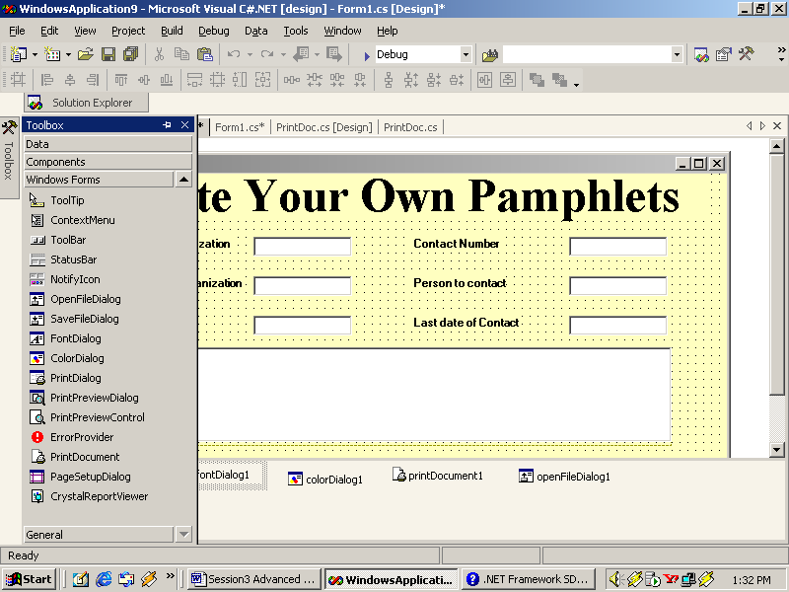
PrintDialog
Properties
AllowSelection
Method
PrintToFile
Reset
AllowPrintToFile
AllowSomePages

Slide 19
MessageBox
MessageBox
The Code for Showing Messagebox is :-
MessageBox.Show(“[Message]”);
MessageBox.Show method is overloaded in twelve ways to give more functionality

Slide 20
MessageBox Contd…
Overload
Public static DialogResult Show(string);
Public static DialogResult Show(IWin32Window, string);
Public static DialogResult Show(string, string);
Public static DialogResult Show(IWin32Window, string, string);
public static DialogResult Show(string, string, MessageBoxButtons);
public static DialogResult show(IWin32Window, string string, MessageBoxButtons);
public static DialogResult Show(string, string, MessageBoxButtons, MessageBoxIcon);

Slide 21
MessageBox Contd…
Overload
public static DialogResult Show(IWinWindow, string, string, string, MessageBoxButtons, MessageBoxIcon);
public static dialogResultShow(string, string, MessageBoxButtons, MessageBoxIcon, MessageBoxDefaultButton);
public static DialogResult Show(IWin32Window, string, string, MessageBoxButtons, MessageBoxIcon, MessageBoxDefaultButton);
public static DialogResult Show(string, string, MessageBoxButtons, MessageBoxIcon, MessageBoxDefaultButton, MessageBoxOptions);
public static DialogResult Show(IWin32Window, string, string, MessageBoxIcon, MessageBoxDefaultButton, MessageBoxOptions);

Slide 22
MessageBox Contd…
The IWin32Window represents the object or control in front of which the messagebox would be displayed
Enumerations that can be displayed on the messagebox are:
MessageBoxButtons
MessageBoxIcon
MessageBoxDefaultButton
MessageBoxOptions

Slide 23
MessageBoxButtons
Member Name
AbortRetryIgnore
OK
OKCancel
RetryCancel
YesNo
YesNoCancel

Slide 24
MessageBoxIcon
Member Name | Member Name
Asterisk | Question
Error | Stop
Exclamation | Warning
Hand
Information
None

Slide 25
MessageBoxDefaultButton
Member Name
Button1
Button2
Button3

Slide 26
MessageBoxOptions
Member Name
DefaultDesktopOnly
RightAlign
RtlReadingService
Notification

Slide 27
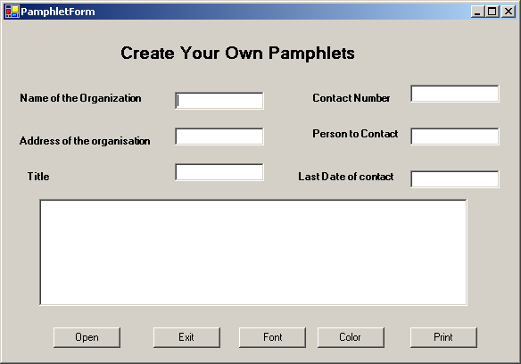
Sample Application

Slide 28
Visual Effects in WinForms
Transparent forms
Control docking
Control Anchoring
Visual Inheritance

Slide 29
Transparent Forms
Opacity
this.Opacity = 0.83;

Slide 30
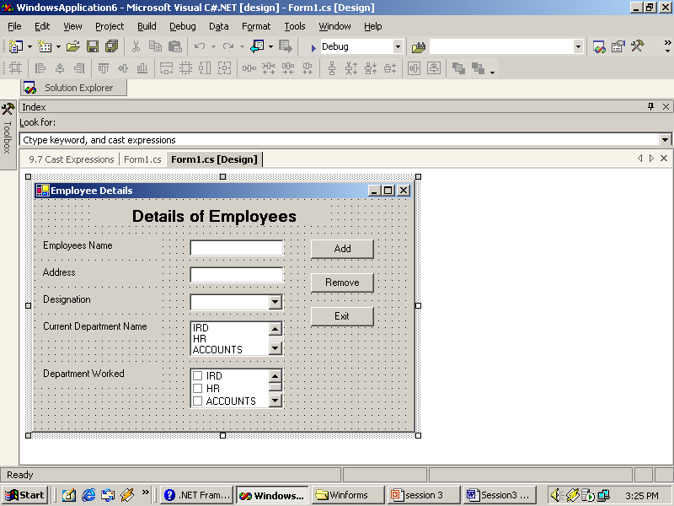
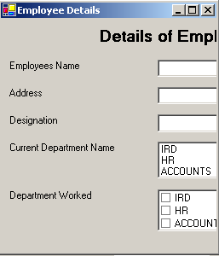
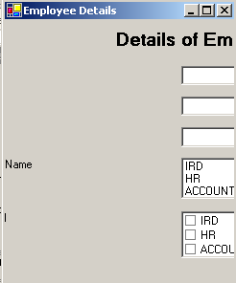
Control Anchoring
Control Anchored
Control not Anchored

Slide 31
Control Docking
Option | Description
Bottom | The control's Bottom edge is docked to the bottom edge of its containing control.
Fill | All the edges of the control are docked to all the edges of its containing control.
Left | The control's left edge is docked to the left edge of its containing control.
None | The control is not docked.
Right | The control's right edge is docked to the right edge of its containing control.
Top | The control's top edge is docked to the top edge of its containing control.
this.DockPadding.Top = 10;

Slide 32
Visual Inheritance
Visual Inheritance
Can create a base Form
Can be used at various places
Also allows changes to be made in the inherited form

Slide 33
Visual Inheritance Contd…
Base Form
  Change the Output type of the project to Class library.
  Set the Modifiers property of the controls in the form to Protected
  Build the solution
Inherited form
  Add a new project to the same Solution
  Add reference to the Base form class library
  Add an Inherited Form
  Select the form to be inherited in the Inheritance Picker
  Modify the controls as per requirement in the Inherited form
  Set the Single Startup Project of the Solution to the Project Name that contains the Inherited form

Slide 34
Summary
Different Print support controls supported by Win Forms are:
  PrintDocument
  PrintPreviewControl
A Dialog box is a temporary window that contains controls to display information or accept choices from use.
Depending on the nature of behavior, a dialog box may be classified as: Modal and Modeless
OpenFileDialog : Used to open files.
PageSetUpDialog : Used to set the Page options such as Paper size, Left margin and Right margin.
FontDialog : Used to specify the font specifications such as the font name, size and color.

Slide 35
Summary Contd…
ColorDialog : Used to select a color. Displays a wide variety of colors and allows us to select from those displayed colors.
SaveFileDialog : Used to specify the filename and save files.
PrintPreviewDialog : Used to view how the document would look after printing.
PrintDialog : Used to set print specifications such as number of copies, the printer and what is to be printed.
The MessageBox dialog is used to display messages.
Some of the Visual Effects supported in WinForms :
  Transparent Forms
  Control Docking
  Control Anchoring
  Visual Inheritance

